Slide 1


Slide 2
Problem to Solve
’s
United States, the United Kingdom, France, Germany, Italy, Japan and Switzerland
4/5 of insured consider insurers NOT TRUSTWORSTY
Insurance: The root causes of low trust (2023) FintechOS. Available at: https://fintechos.com/blogpost/insurance-the-root-causes-of-low-trust/ (Accessed: 14 October 2023).
Notes:
Now there is problem, user not trust company
Insurance is very important
So how

Slide 3
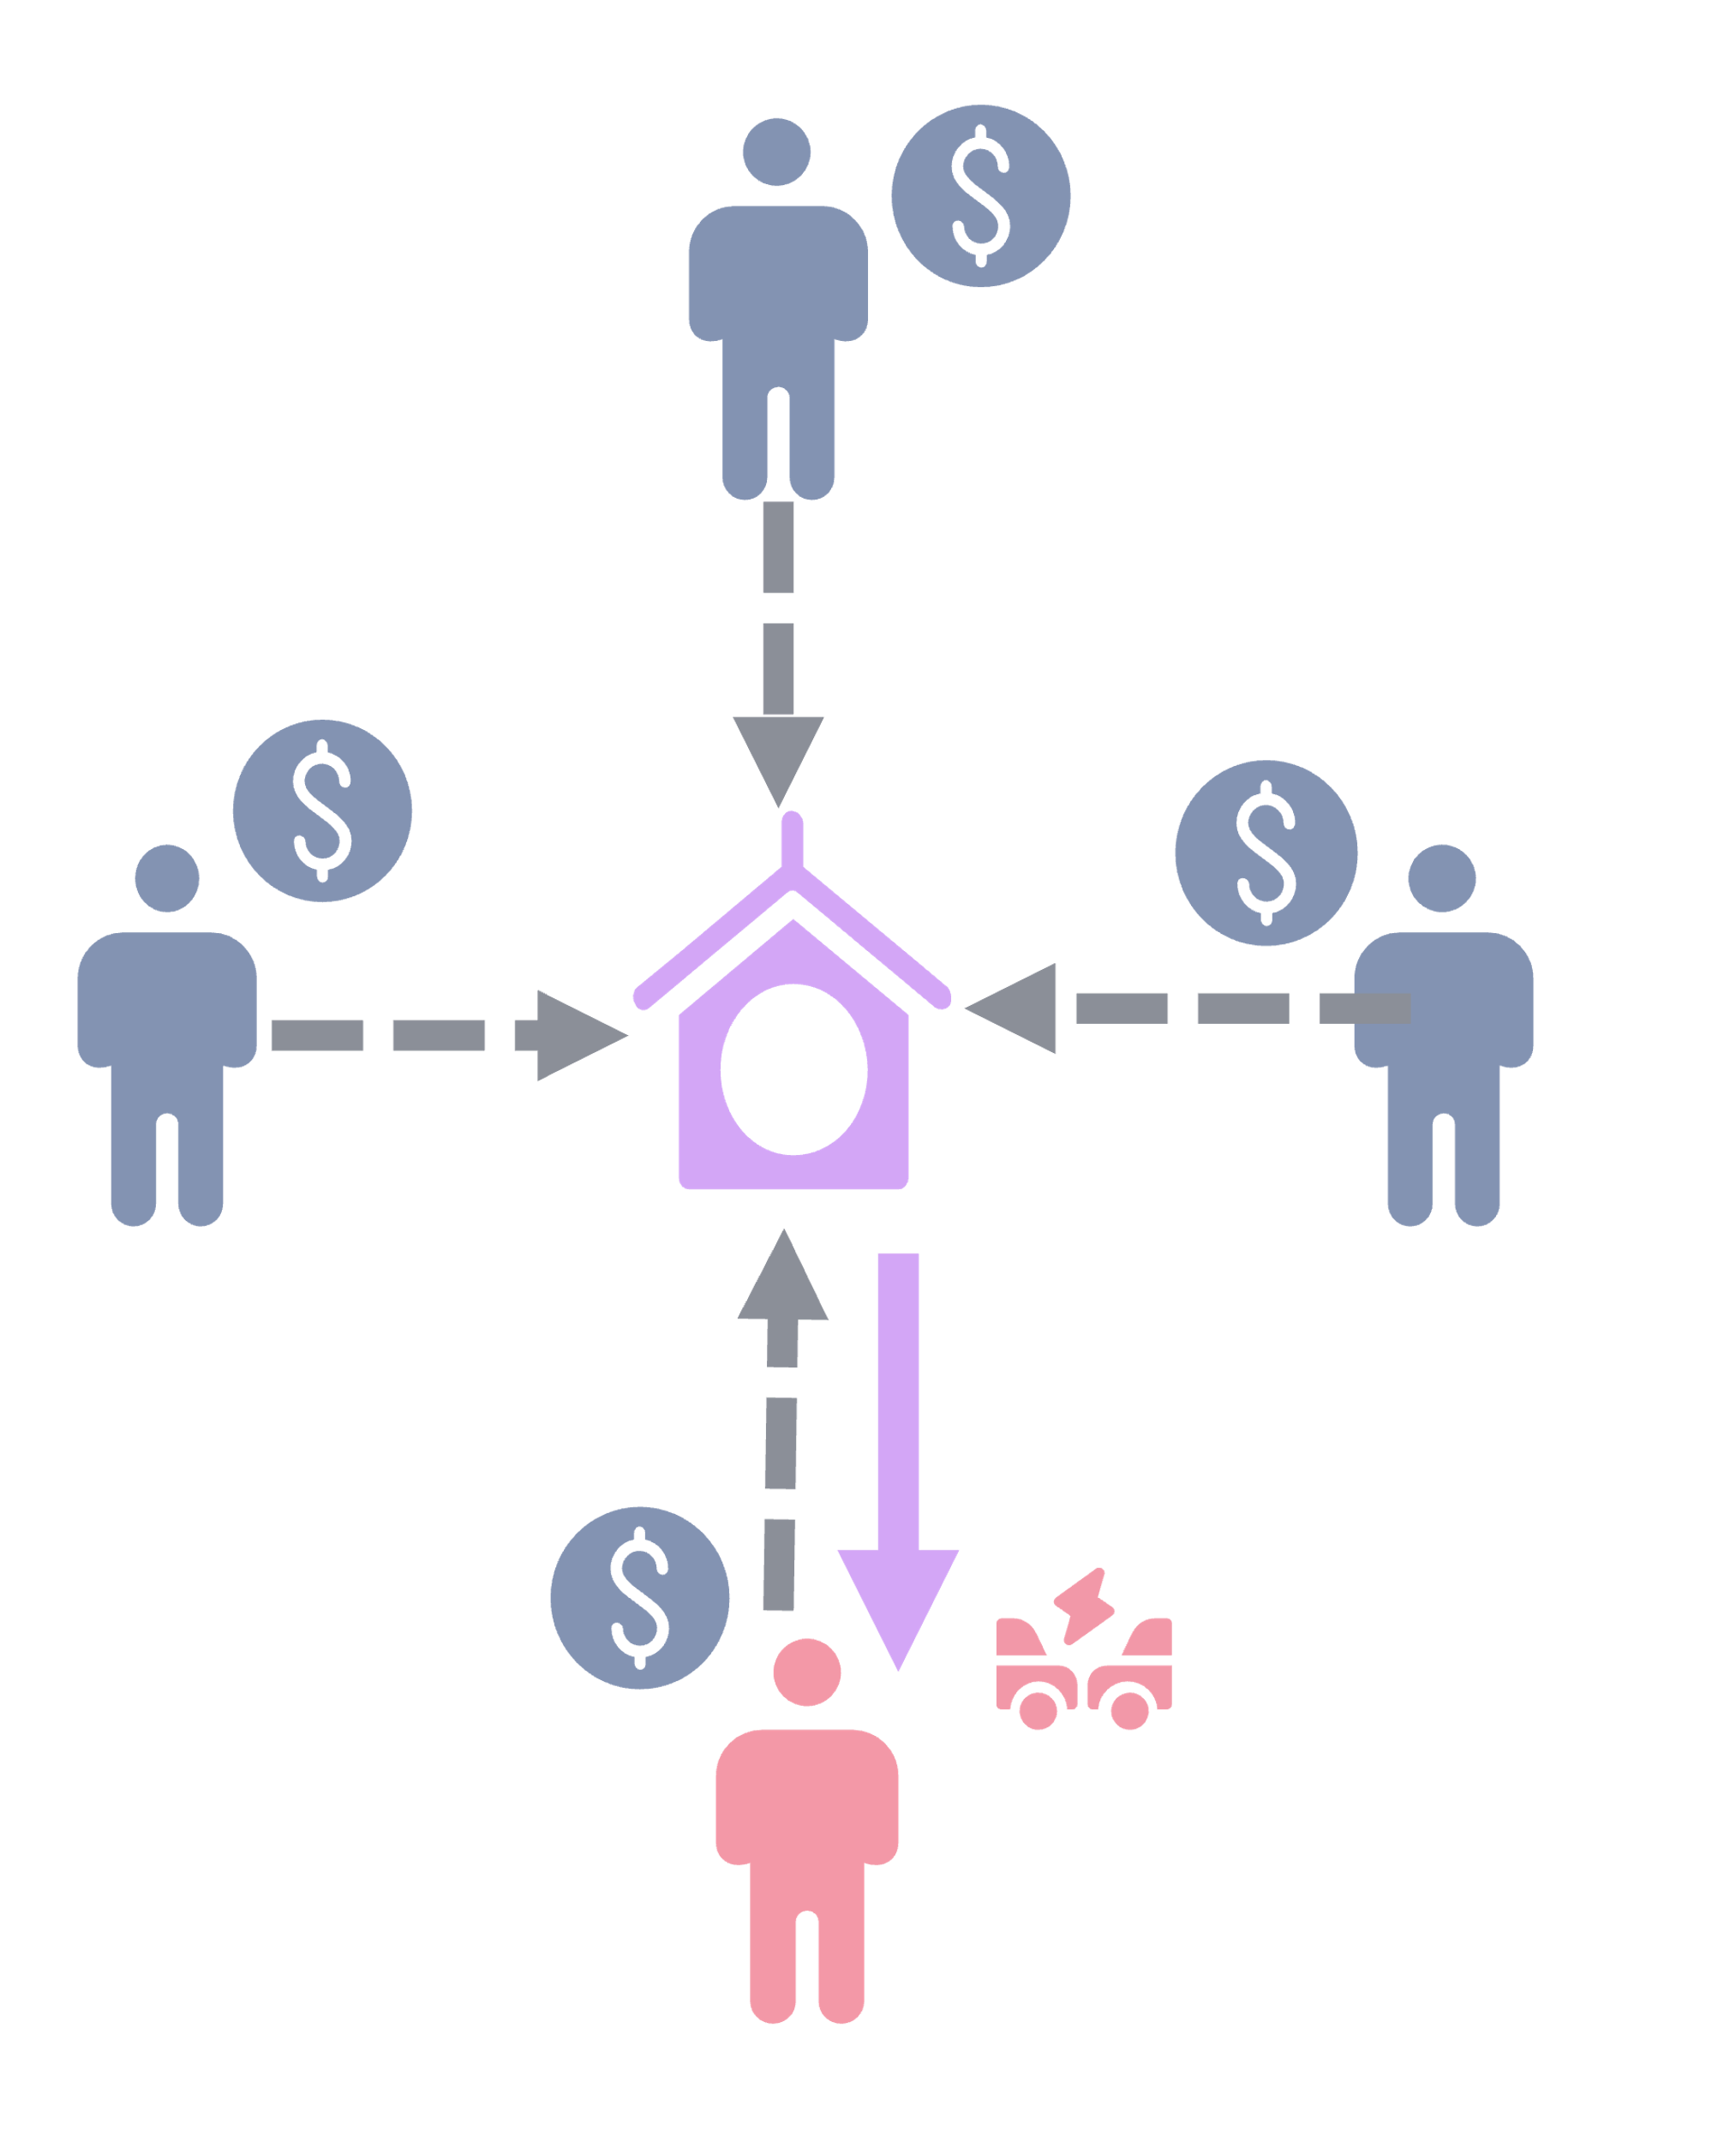

Problem to Solve
’s
Regular Insurance
Notes:
The regular insurance basically is collect everyone money together and give a person when he or she meet accident.
However, there is a centralize company to approve all claiming

Slide 4

Solution
’s
Regular Insurance
Notes:
Due to the issue, we proposed a decentralize node to replace the centralise insurer

Slide 5

Highlight
’s
Community Reputation System
Smart Contract
Community-Led Approval
Notes:
The 3 main highlight is here

Slide 6
Concept
’s
Approval
Send to community
Approval
Unknown
Reject
Smart Contract
Community-Led Approval
Reject
Update the smart contract behavior
Notes:
First, smart contract will first analyse the claiming. It will go thru the predefined rule, and make an decision.
However, if the decision is unable to be make it will trigger the community led approval

Slide 7
Concept
’s
Approval
Send to community
Unknown
Approval
Smart Contract
Community-Led Approval
Reject
Might happen to me also…
Contribute biasness
Update the smart contract behavior
Notes:
However, there is a concern here. Since the community is one of the policy beneficial, they will incline to approve the case with the mind of
It might be happen to me also. This will contribute bias to smart contract

Slide 8
Concept
’s
Approval
Handling voting weightage
Send to community
Unknown
Smart Contract
Community Reputation System
Community-Led Approval
Reject
Approval and Reject entries is the ground truth
Notes:
Hence, we introduce a community reputation system to handle the voting weightage.
We will include some of the approval and reject case in the system as ground truth, and this is to check if the user is biasness
If found, the respective user vote may given a lower weightage.
To encourage the involvement, the system can also give some credit to the quality decision user based on her given voting.

Slide 10
inShield
by FeatureMining
Where Community Shapes Insurance

